Slide 1
Term Deposit Subscription Prediction
By
Kaushik
Angeline
Mohammed Faiz

Slide 2
Problem Statement
The data is related to direct marketing campaigns (phone calls) of the banking institution. The marketing campaigns were based on phone calls. Often, more than one contact to the same client was required, in order to access if the product (bank term deposit) would be ('yes') or not ('no') subscribed.

Slide 3
Data Description
age: Age(numeric) of each customer
job : Type of job (categorical: 'admin.', 'blue-collar', 'entrepreneur', 'housemaid', 'management', 'retired', 'self-employed', 'services', 'student', 'technician', 'unemployed', 'unknown')
marital : Marital status (categorical: 'divorced', 'married', 'single', 'unknown' ; note: 'divorced' means divorced or widowed)
education: (categorical: 'basic.4y', 'basic.6y', 'basic.9y', 'high.school', 'illiterate', 'professional.course', 'university.degree', 'unknown')
default: Has credit in default? (categorical: 'no', 'yes', 'unknown')
housing: Has housing loan? (categorical: 'no', 'yes', 'unknown')
loan: Has personal loan? (categorical: 'no', 'yes', 'unknown')
contact: Contact communication type (categorical: 'cellular','telephone')
month: Last contact month of year (categorical: 'jan', 'feb', 'mar', ..., 'nov', 'dec')
day_of_week: Last contact day of the week (categorical: 'mon','tue','wed','thu','fri')

Slide 4
duration: Last contact duration, in seconds (numeric). Important note: this attribute highly affects the output target (e.g., if duration=0 then y='no'). Yet, the duration is not known before a call is performed. Also, after the end of the call y is obviously known. Thus, this input should only be included for benchmark purposes and should be discarded if the intention is to have a realistic predictive model.
campaign: Number of contacts performed during this campaign and for this client (numeric, includes last contact).
pdays: Number of days that passed by after the client was last contacted from a previous campaign (numeric; 999 means client was not previously contacted)
previous: Number of contacts performed before this campaign and for this client (numeric)
poutcome: Outcome of the previous marketing campaign (categorical: 'failure','nonexistent','success')
emp.var.rate: Employment variation rate - quarterly indicator (numeric)
cons.price.idx: Consumer price index - monthly indicator (numeric)
cons.conf.idx: Consumer confidence index - monthly indicator (numeric)
euribor3m: Euribor 3 month rate - daily indicator (numeric)
nr.employed: Number of employees - quarterly indicator (numeric)
y - Has the client subscribed a term deposit? (binary: 'yes', 'no')

Slide 5
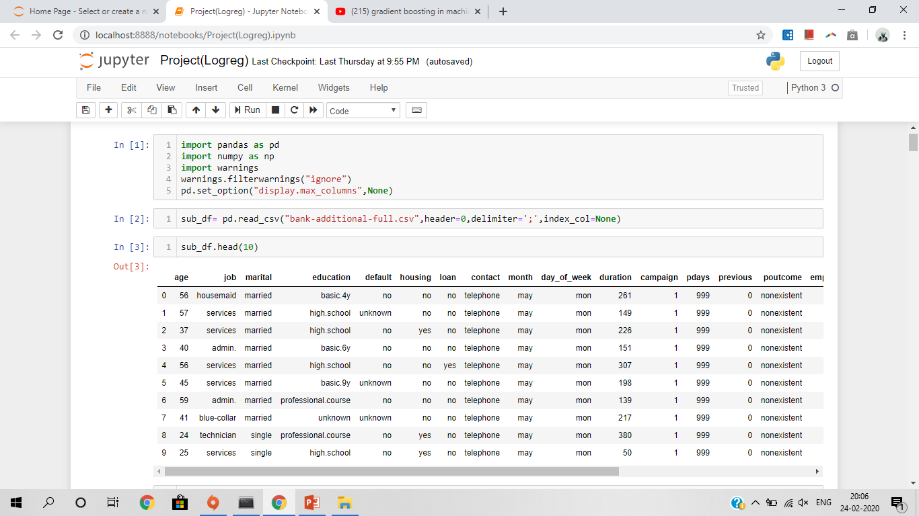
Data Preprocessing

Slide 6
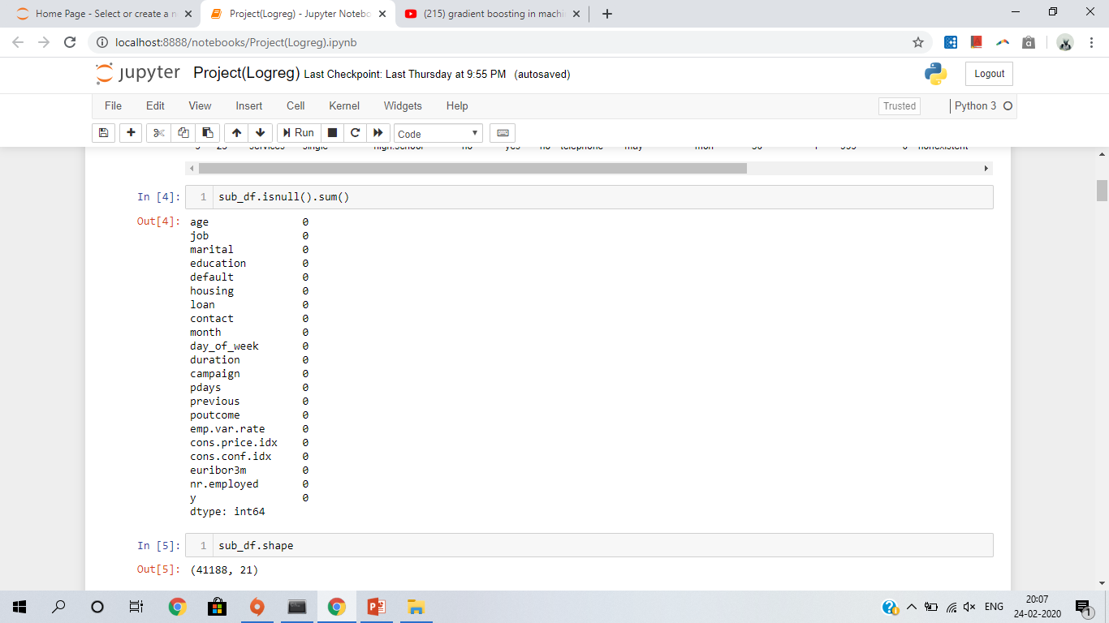

Slide 7
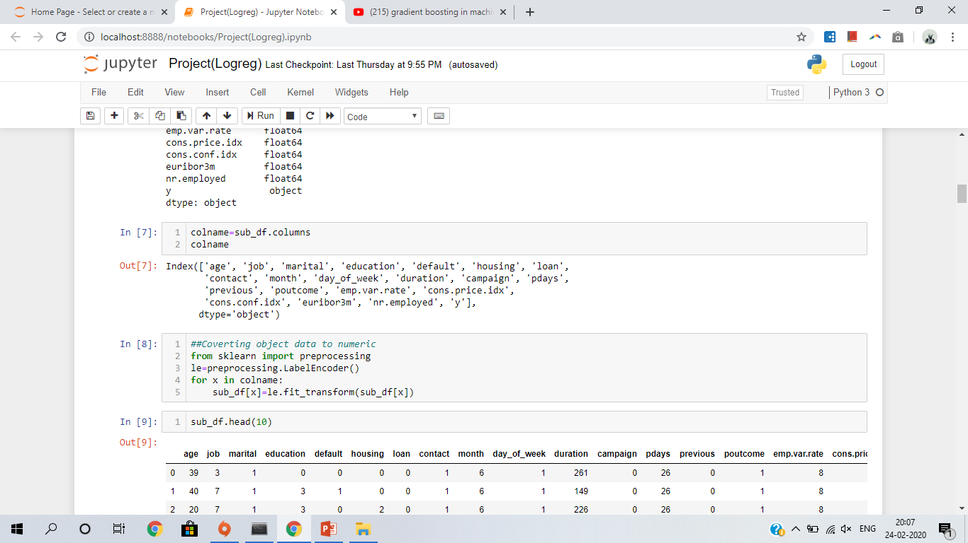

Slide 8
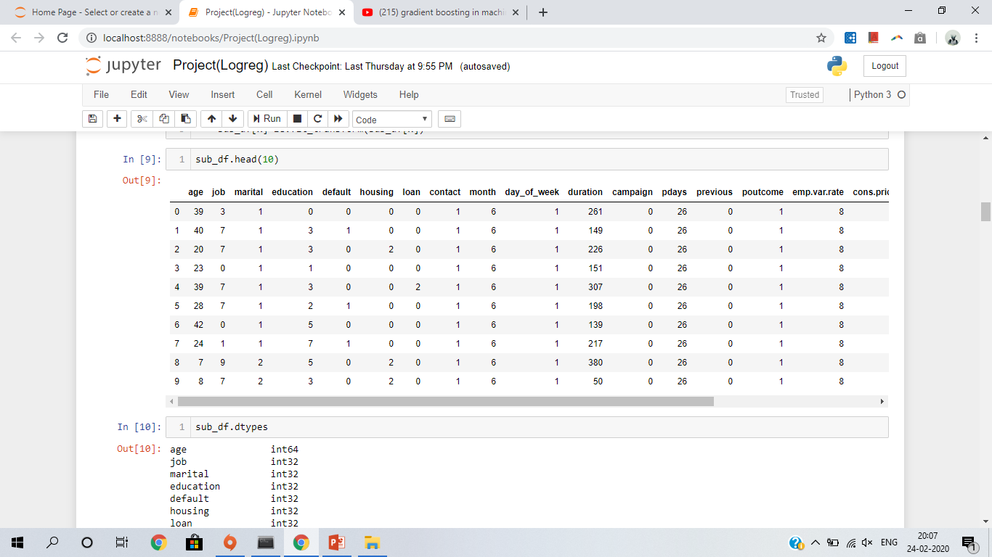

Slide 9
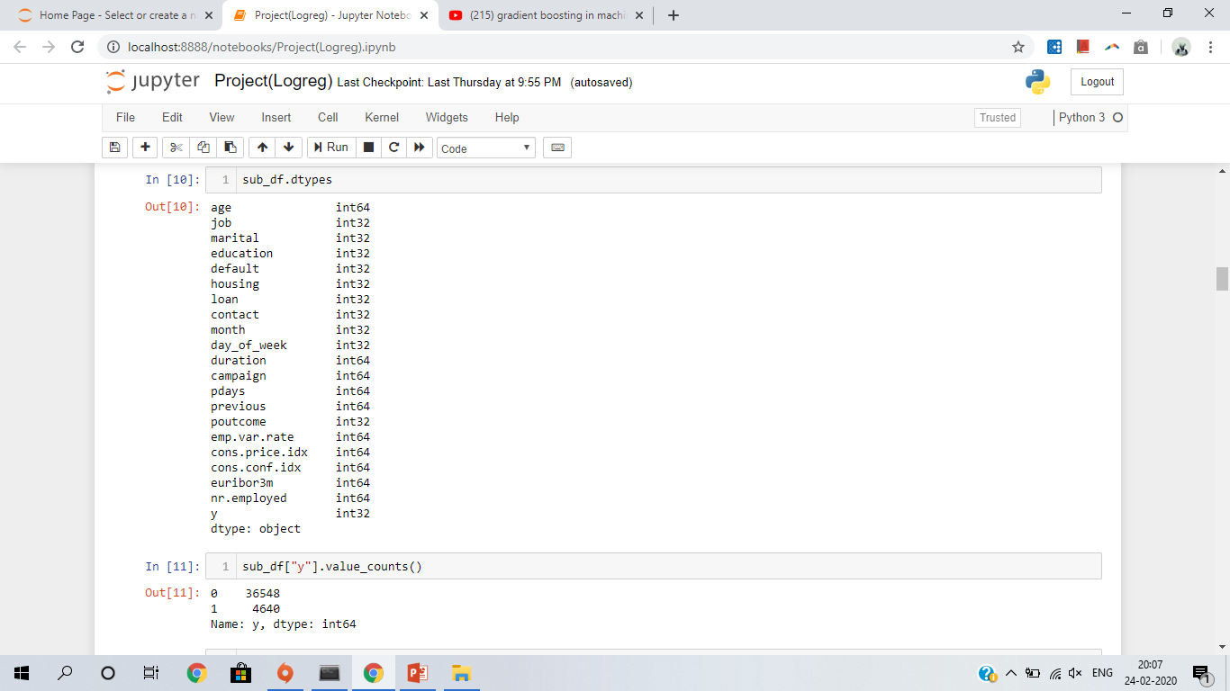

Slide 10
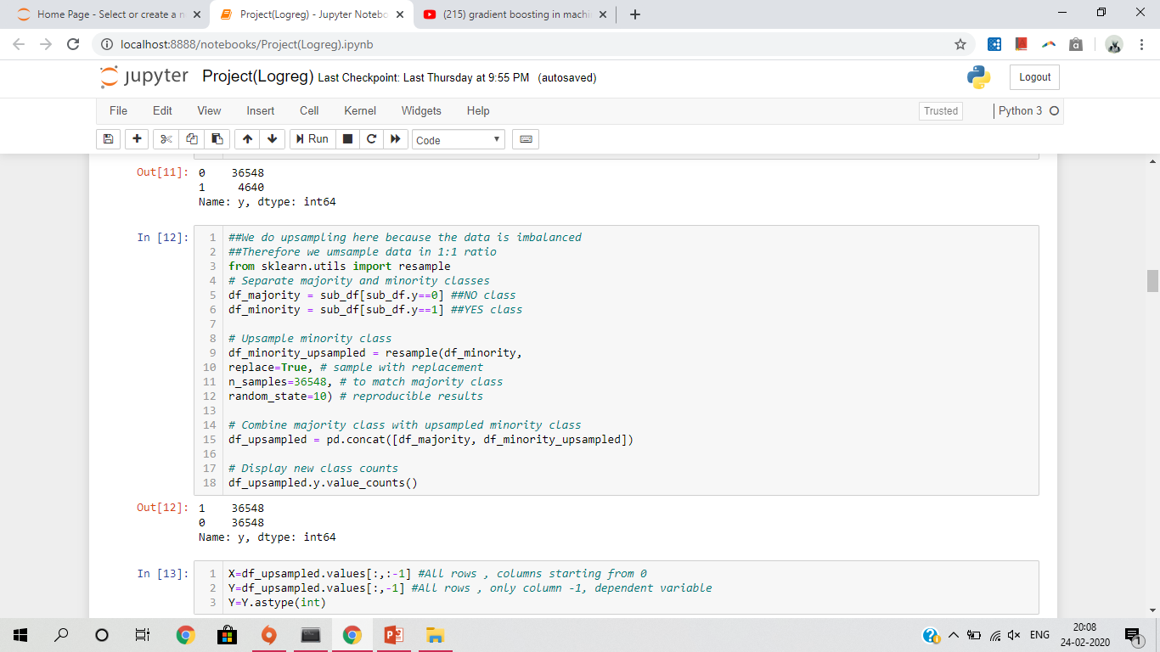
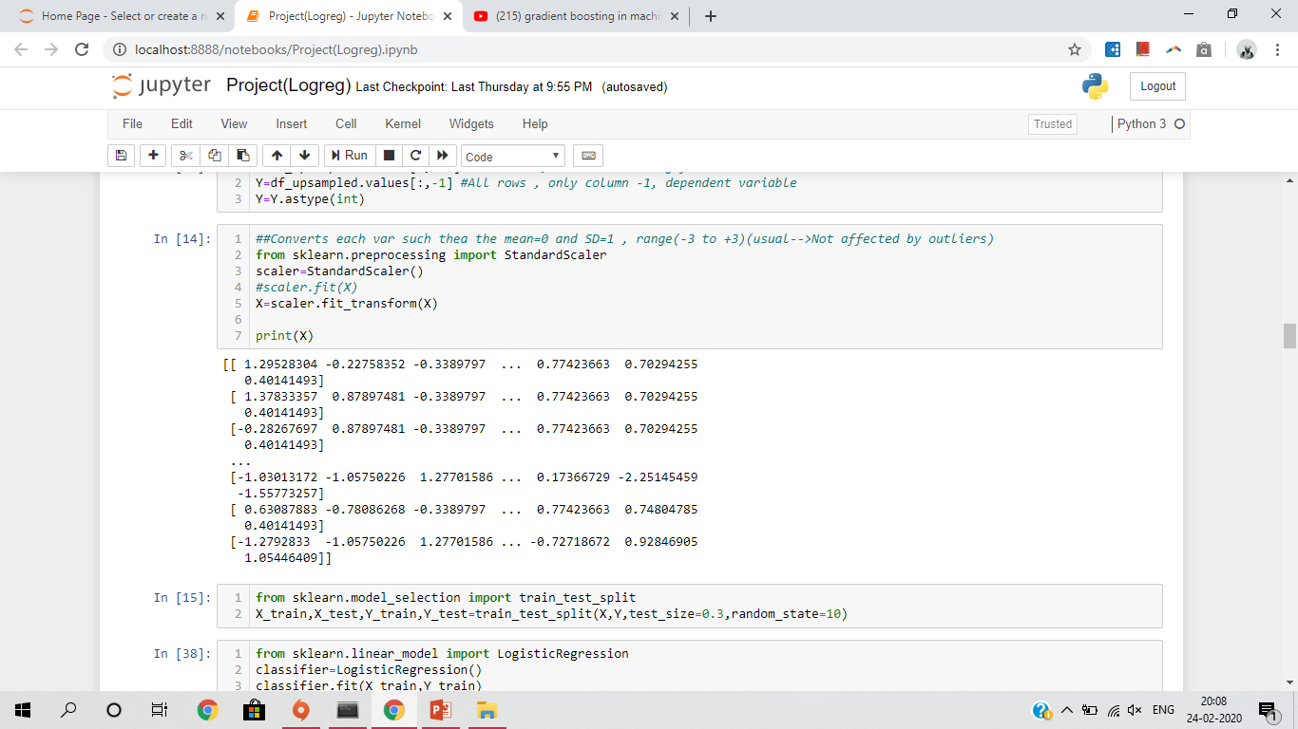

Slide 11
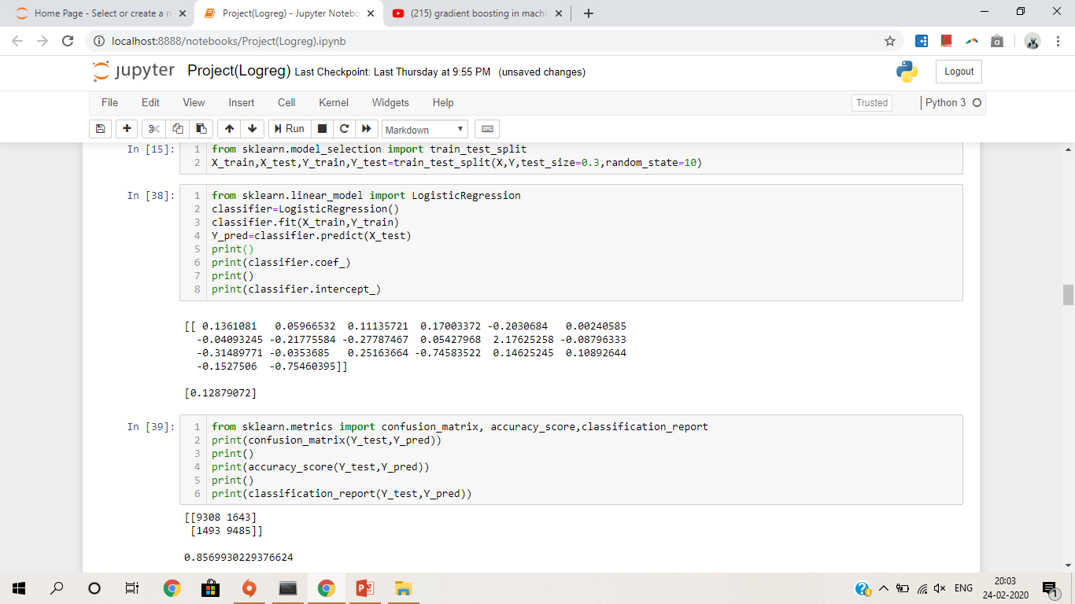
Logistic Regression

Slide 12
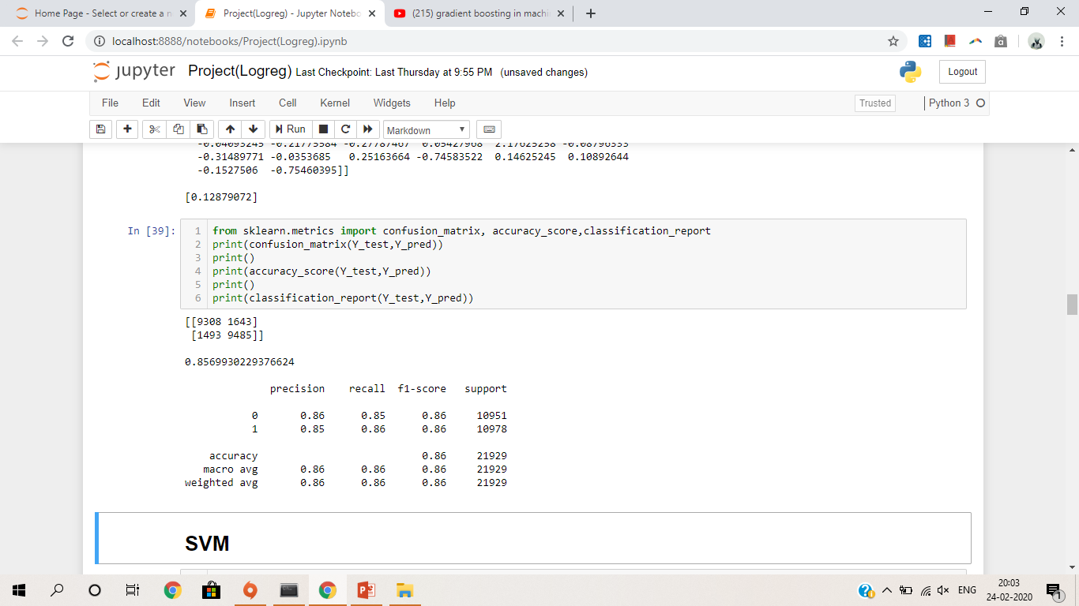
Confusion Matrix, Accuracy score, Classification Report

Slide 13
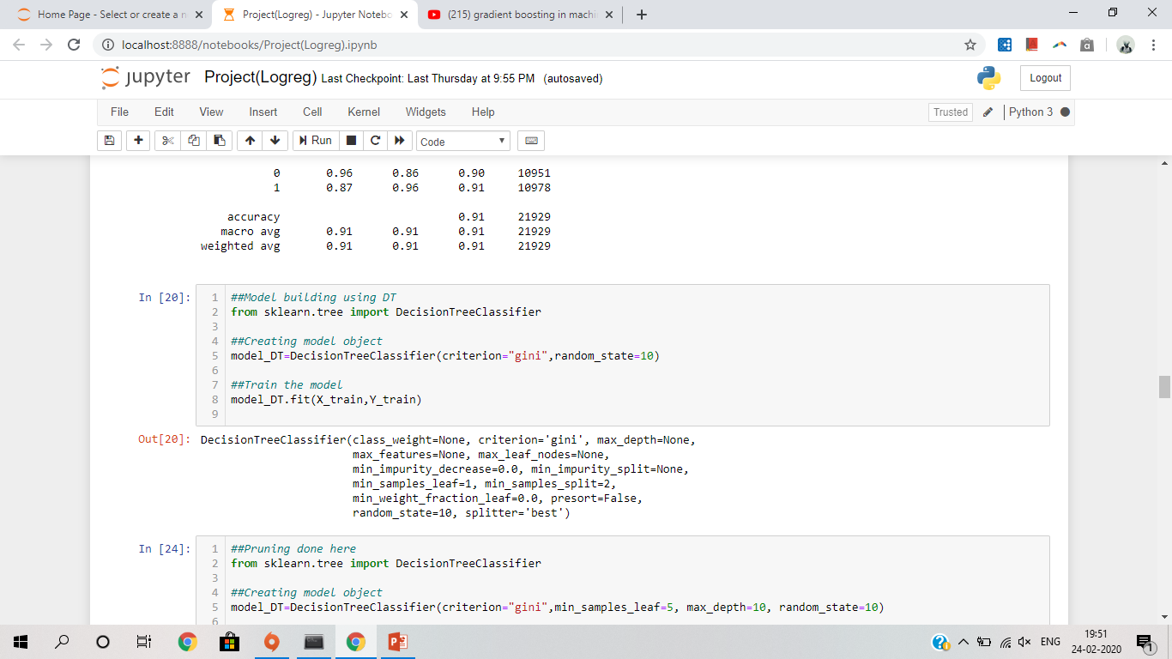
Decision Tree Before Pruning

Slide 14
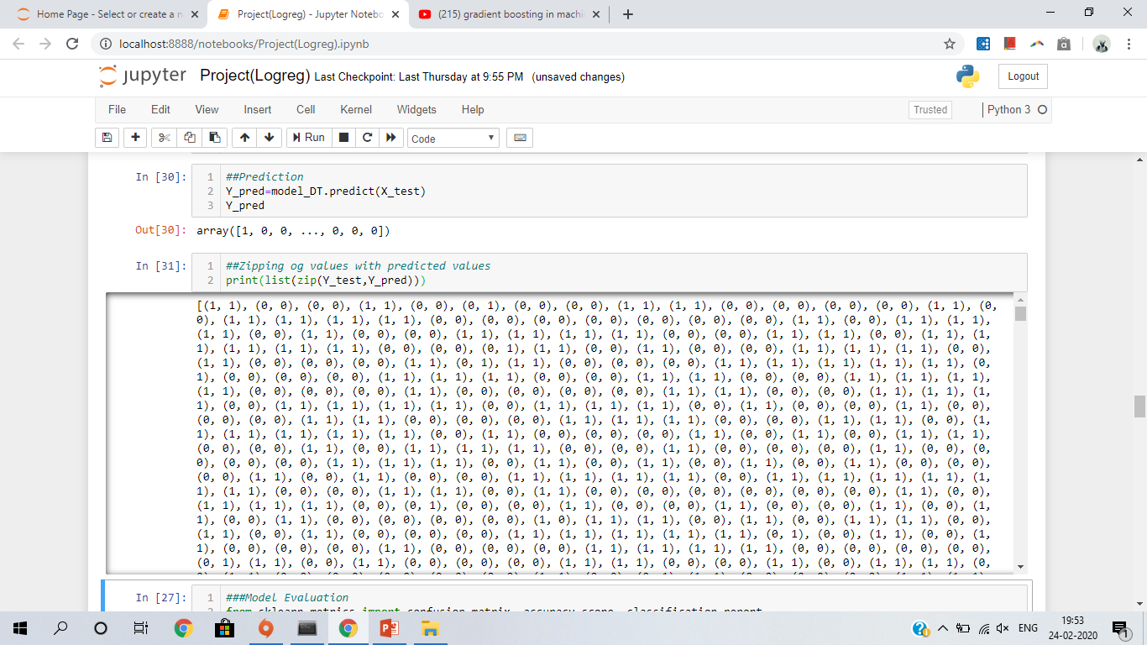

Slide 15
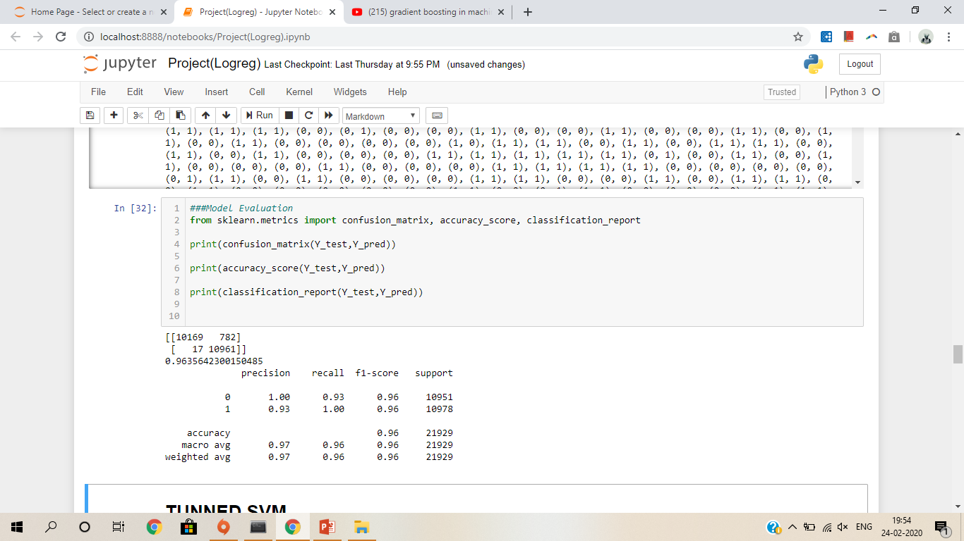
Confusion Matrix, Accuracy score, Classification Report

Slide 16
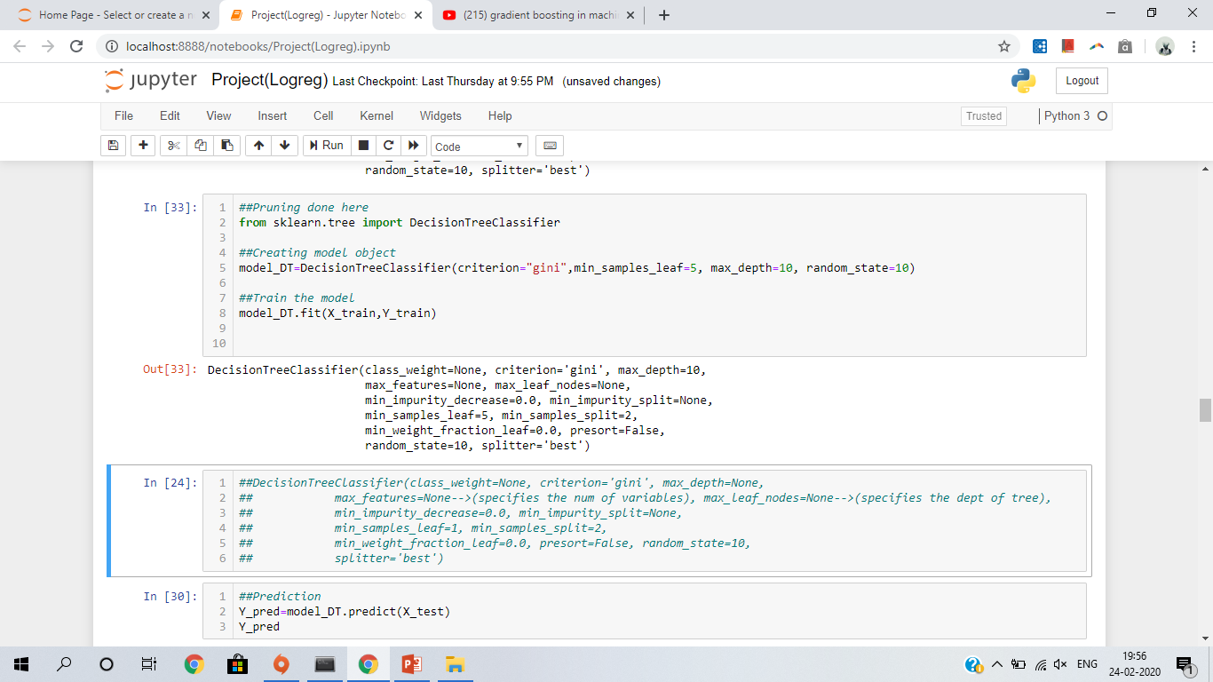
After Pruning

Slide 17
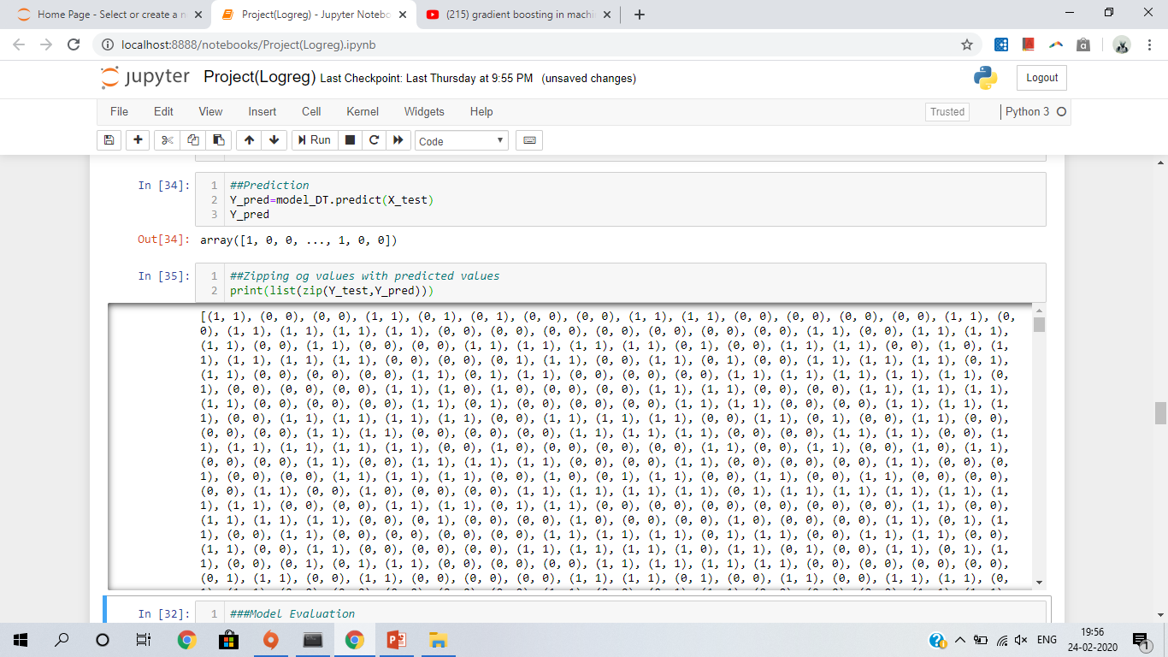

Slide 18
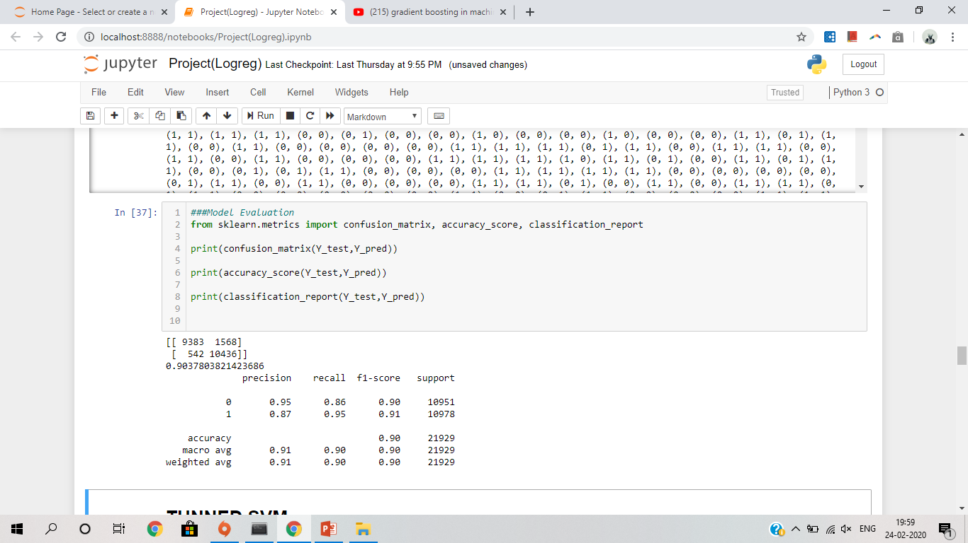
Confusion Matrix, Accuracy score, Classification Report

Slide 19
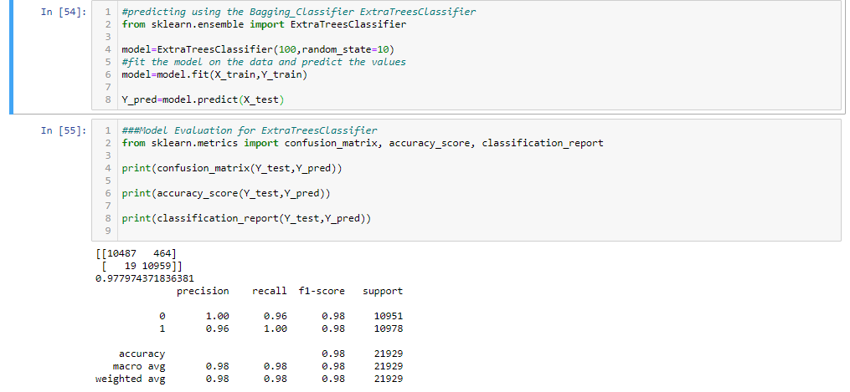
Extra Trees Classifier

Slide 20
THANK YOU

